Slide 1
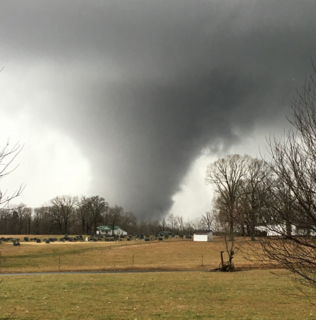
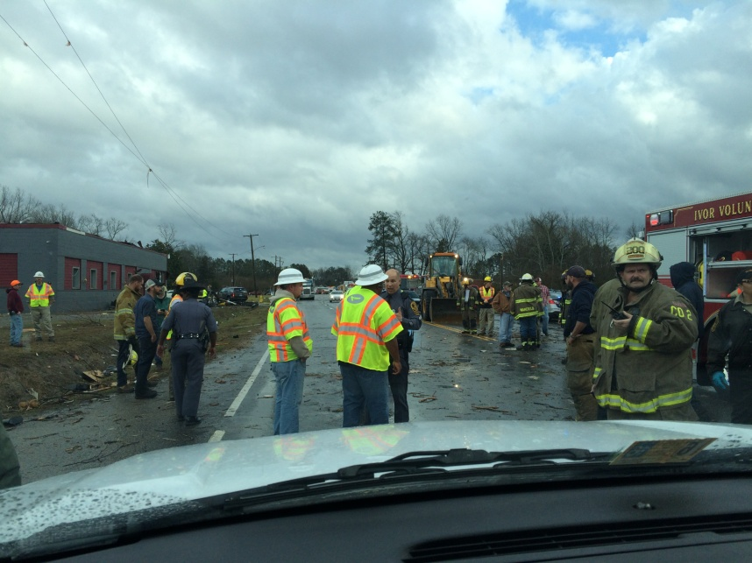
February 24, 2016 Tornado Outbreak
Overview of Presentation
Presenters
Storm evolution
Eddie Vick – Sussex County
Waverly Tornado
Bobby Wingfield – Appomattox County
Appomattox Tornado
Bruce Sterling – VDEM
Gene Stewart – VDEM
Photo Courtesy of Jason Smith
Notes:
Mention the other storms (Essex/Richmond/Lancaster, Mecklenburg/Patrick/Fluvanna)

Slide 2
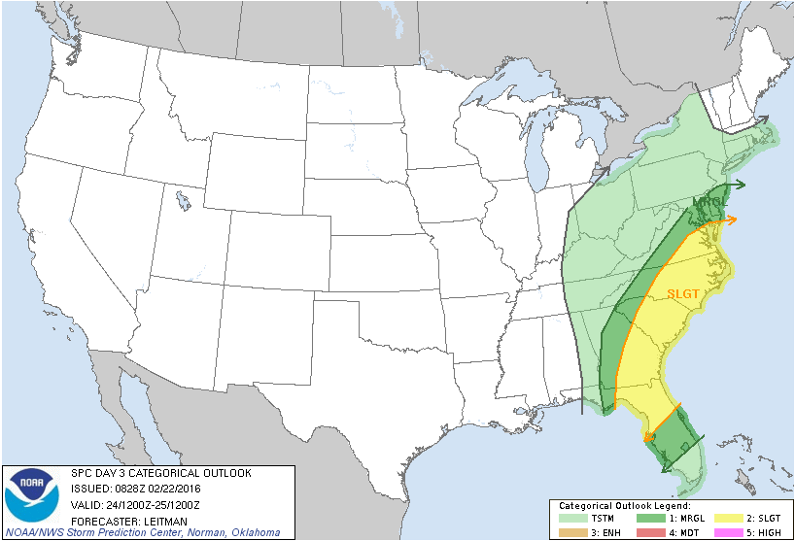
Day 3 SPC Convective Outlook
Issued 02/22/2016 0328
Effective 02/24/2016 0700
Notes:
Day 3 Outlook issued on Monday, February 22 at 0328.
Note the slight risk in Day 3 – very unusual
Local AFOs sending “heads up” emails to EMs
Concerns of heavy rainfall and severe weather

Slide 3
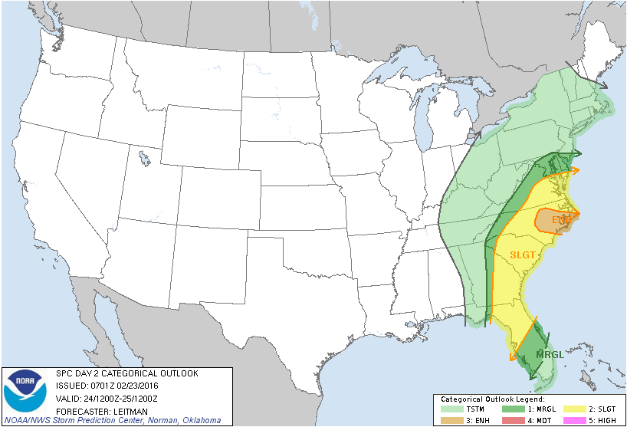
Day 2 SPC Convective Outlook
Issued 02/23/2016 0201
Effective 02/24/2016 0700
Notes:
Day 2 Outlook issued on Tuesday, February 23 at 0201
Enhanced risk added to Eastern NC
NWS offices sending updated info to EMs
Focus on heavy rain and severe weather

Slide 4
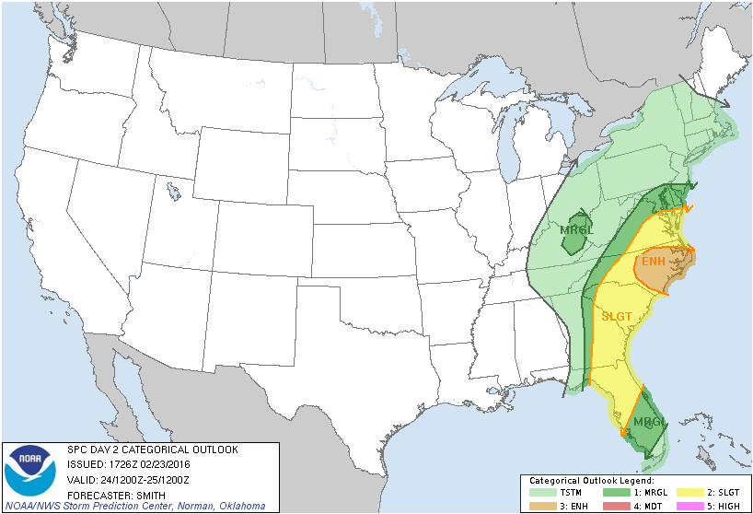
Day 2 SPC Convective Outlook
Issued 02/28/2016 1226
Effective 02/24/2016 0700
Notes:
Day 2 Outlook update issued on Tuesday at 1226
Expands area of Enhanced risk

Slide 5
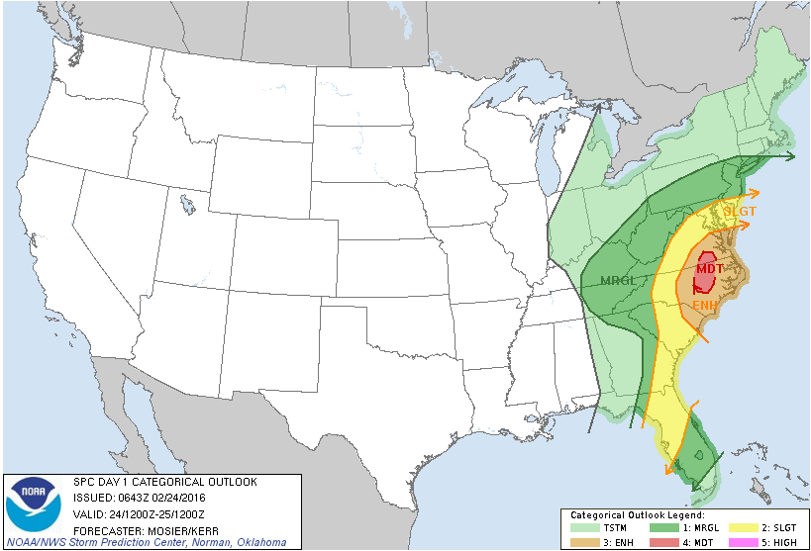
Day 1 SPC Convective Outlook
Issued 02/24/2016 0143
Effective 02/24/2016 0700
Notes:
Day 1 Outlook issued on Wednesday at 0143
Moderate risk introduced into Va/NC – rare

Slide 6
Sent by Bill Sammler at 0849 on 2/24
Notes:
Bill S sends event dashboard
Heavy rain/flooding risk lower
Established timelines for severe weather – 1500-2200
VEOC participated in 0900 conf call with NWS
Westmoreland schools cancel after school events - 1100

Slide 7
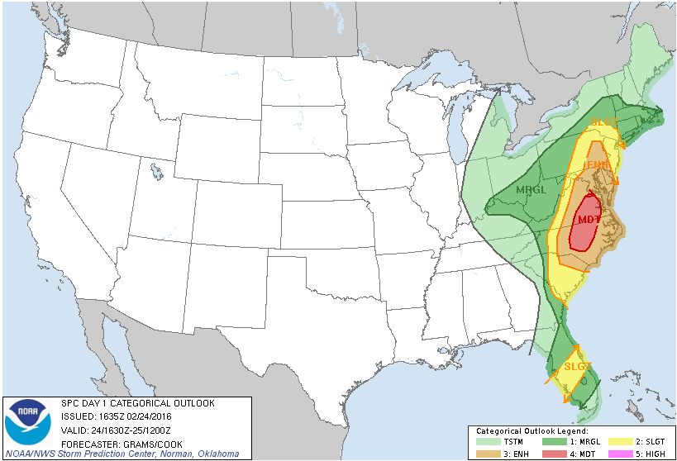
Day 1 SPC Convective Outlook
Issued 02/24/2016 1135
Effective 02/24/2016 1130
Notes:
Updated Day 1 Outlook issued at 1135
Moderate risk grows, covering most of eastern Virginia
FEMA/SPC/State conference call at 1215
ESF 12 reaching out to Dominion Power & Coops
Area of concern east of Lynchburg to Reidsville
WebEOC event created

Slide 8
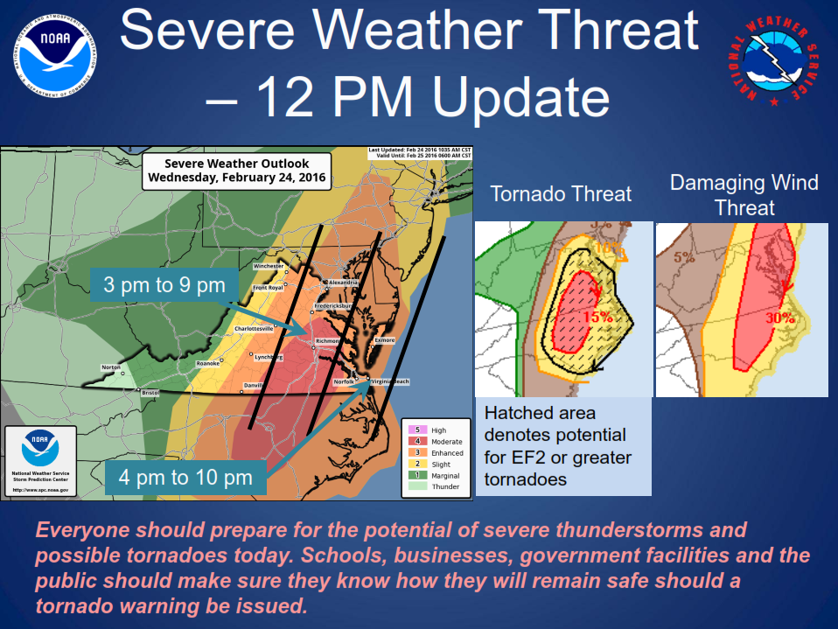
Sent by Bill Sammler at 1230 on 2/24
Notes:
Update by Bill S sent at 1230
Most significant severe wx moved NW 30-60 miles
I-96, Richmond, Tri-Cities, Farmville, Tappahannock, SH

Slide 9
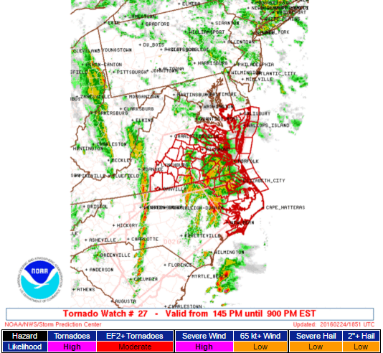
Notes:
Tornado Watch #27 issued by SPC at 1345
Includes Central and Eastern Virginia
High threat of tornadoes & severe wind
Moderate threat of EF2 and higher tornadoes

Slide 10
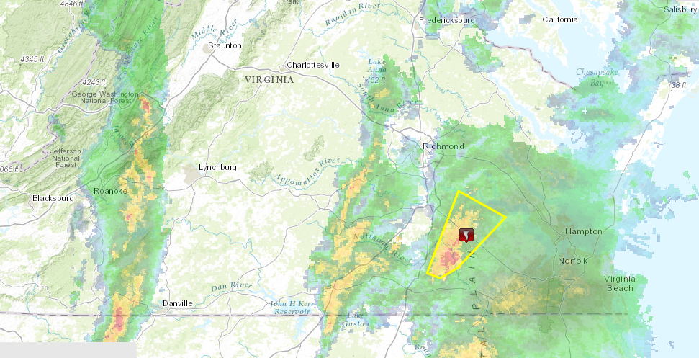
Waverly Tornado
Severe Thunderstorm Warning
Issued 1420 hrs
Notes:
Severe thunderstorm warning issued for Sussex, Surry,
& Prince George Counties at 1420 moving NE 45 mph
Anticipated to arrive in Waverly at 1435
Capable of producing 70 mph winds
Indicates storm could possibly produce tornadoes

Slide 11
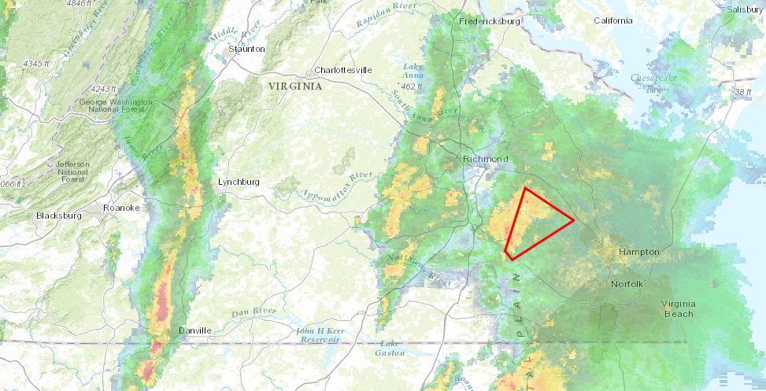
Waverly Tornado
Tornado Warning
Issued 1437 hrs
Notes:
Tornado warning issued at 1437 – storm located over
Waverly moving NE 45 mph
1443 VSP trooper receives call via SIRS from Sussex
dispatch regarding people trapped from a tornado in
Waverly
1454 – B Sterling enroute to Waverly
Called Eddie Vick – he was in Front Royal
1535 – Received call from Eddie reporting 3
unconfirmed fatalities
1544 – Twitter reporting 2 unconfirmed fatalities
1553 – B Sterling arrives in Waverly
CP moved to vacant grocery store
Approx 100 responders – VSP, DGIF, VDOT, Local LE & Fire
Primary focus was SAR
Halted response due to second round of storms
1653 – Sussex declares local emergency
1706 – Governor declares state of emergency
Coordinated with VSP, EOC, County
2100 – Conference call with regional staff

Slide 12
Timeline of Events
Monday – February 22
Day 3 Outlook
NWS email warning of severe weather
Tuesday – February 23
Day 2 Outlook
Slide Hidden – for talking point use only

Slide 14
Timeline of Events
Wednesday – February 24
Day 1 Outlook
NWS email with update
0900 conference call with NWS Wakefield/Blacksburg /VEOC
1200 – NWS email update
1200 – VEOC issues Executive Dashboard
1215 conference call with SPC/FEMA/VEOC
1300 – VEOC issues Spot Report #1
1345 – SPC issues Severe Thunderstorm Watch #27
Slide Hidden – for talking point use only
1420 – NWS Wakefield issues Severe Thunderstorm Warning for Sussex County
1437– NWS Wakefield issues Tornado Warning for Sussex County
1443– VSP enroute to Waverly due to people trapped from tornado
1454– B. Sterling enroute to Waverly – 1537 emergency response
1544– Twitter reports of 2 unconfirmed fatalities in Waverly
1553– B. Sterling arrives in Waverly
1527 – NWS Blacksburg issues first Tornado Warning for Appomattox County
1621 – G. Stewart enroute to Appomattox County
1653 – Sussex County declares local emergency
1706 – Governor McAuliffe declares State of Emergency
1718 – Appomattox County declares local emergency
2100 – Conference call with regional staff

Slide 15
Timeline of Events
Thursday – February 25
Governor’s visit
Volunteers arrive to assist with cleanup
Friday – February 26
Volunteers assist with cleanup
Saturday – February 27
FEMA PDA Teams arrive
Sunday – February 28
Slide Hidden – for talking point use only
FEMA PDA Teams complete assessment

Slide 16
Turn over to Eddie to discuss Sussex County activities
Slide Hidden – for talking point use only

Slide 17
Waverly Tornado Talking Points
Out of County when the incident struck
Received phone call from Bruce Sterling and asked him for assistance.
Attempted to manage incident by phone while driving back to the County (4 hours)
Communicated by phone with Bruce, my Supervisor and the Incident Command staff consistently
Once I arrived, got briefed by the Incident Command we continued to search for any victims.
Opened EOC and Managed Incident
Conducted a Briefing with EOC Staff and Town Officials
Assigned functions: Security, News Media, Roadway and debris cleanup management and resource and donation management.
EOC was setup by functions
Slide Hidden – for talking point use only
Volunteers, resources, and donation management function (first order of business, assigned to Joe)
Eddie will discuss these points
Vacant grocery store setup to receive, manager and disperse resources to the community.
Two (2) Town Council members of Waverly in Logistics for the Military
while photos display with
We received assistance from the City of Chesapeake, Virginia Emergency Management Office (much needed and Welcomed)
slideshow

Slide 18
Cleanup Efforts and Damaged Property
VDOT, Waste Management, the Town of Waverly Public Utility Department and Volunteers restored the Town by Saturday evening
Over 1000 volunteers assisted is the cleanup (many military and local origination groups) (Saturday had 500 to 600 working at once)
Damage assignment conducted on Wednesday (day after Tornado)
Communicated by phone with Bruce, my Supervisor and the Incident Command staff consistently
3 resident lost their lives, 8 persons were injured, 56 properties were effected, 42 properties had minor damage, 8 had major damage and 6 were destroyed.
All effected structures (that could be) were secured with Tarps/plywood by Saturday evening
VDOT removed all debris and Waste Management accepted all debris at the landfill (including woody debris from personal property, curb side)
FEMA made assessment on Saturday
Lessons Learned
Slide Hidden – for talking point use only
How to setup (or not) Disaster Funding and manage those accounts
Eddie will discuss these points
Setup function to deal with Donations, Volunteers, Media Outlets and volumes of phone calls during the incident
Staffed “Help or Hot Lines” during the incident. Also, to give information about donation and financial assistance.
while photos display with
Plans to reroute resources and shut down local assistance
Disaster Assistance from many Originations
Sussex recovery (beyond insurance properties) is being conducted by a National Faith Base Origination
slideshow
Disaster Funding was given to a 501 C3 Corporation to manage the funding and assistance with building materials of the effected properties.
Ensure communication sharing with all stakeholders (very effective)
Consider a Recovery Plan and/or a process to use if a Larger disaster strikes

Slide 19
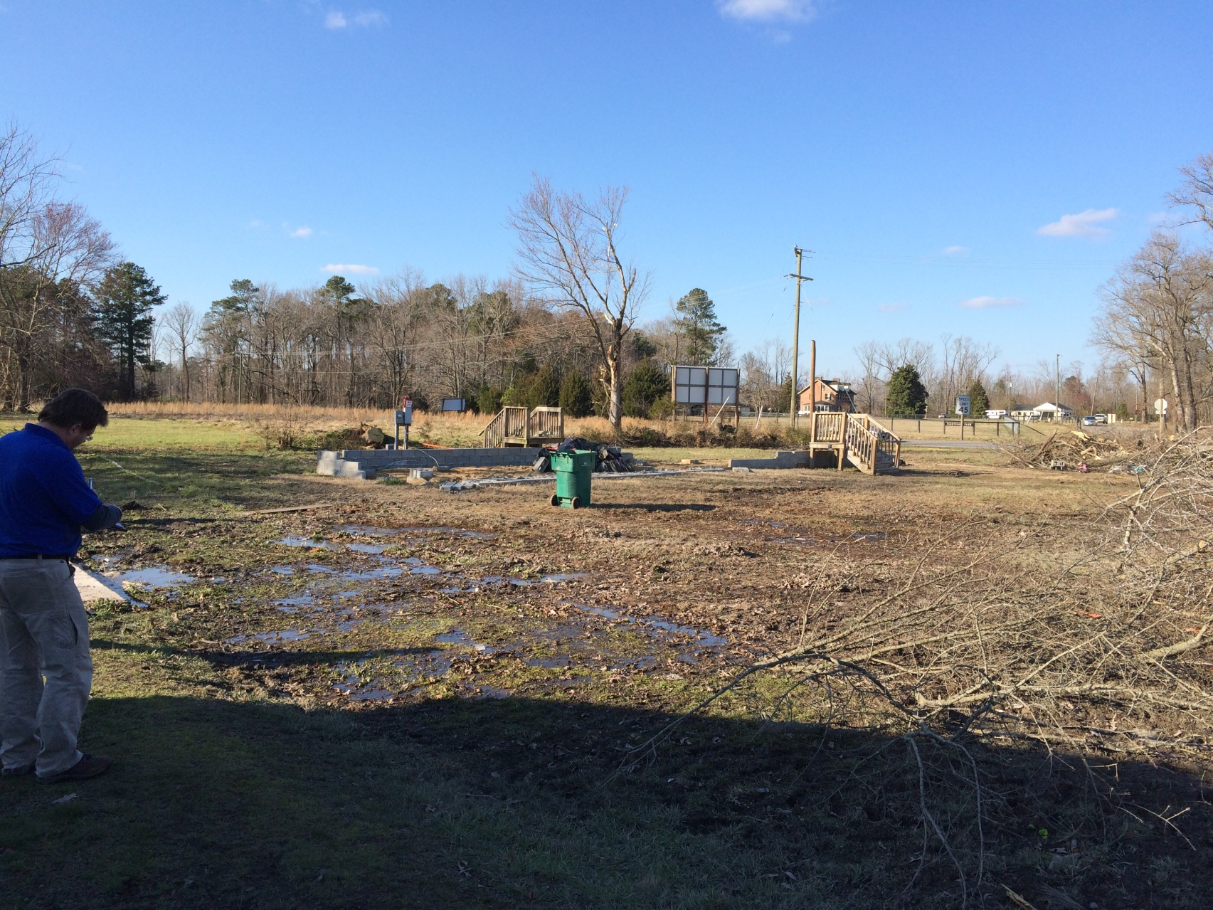
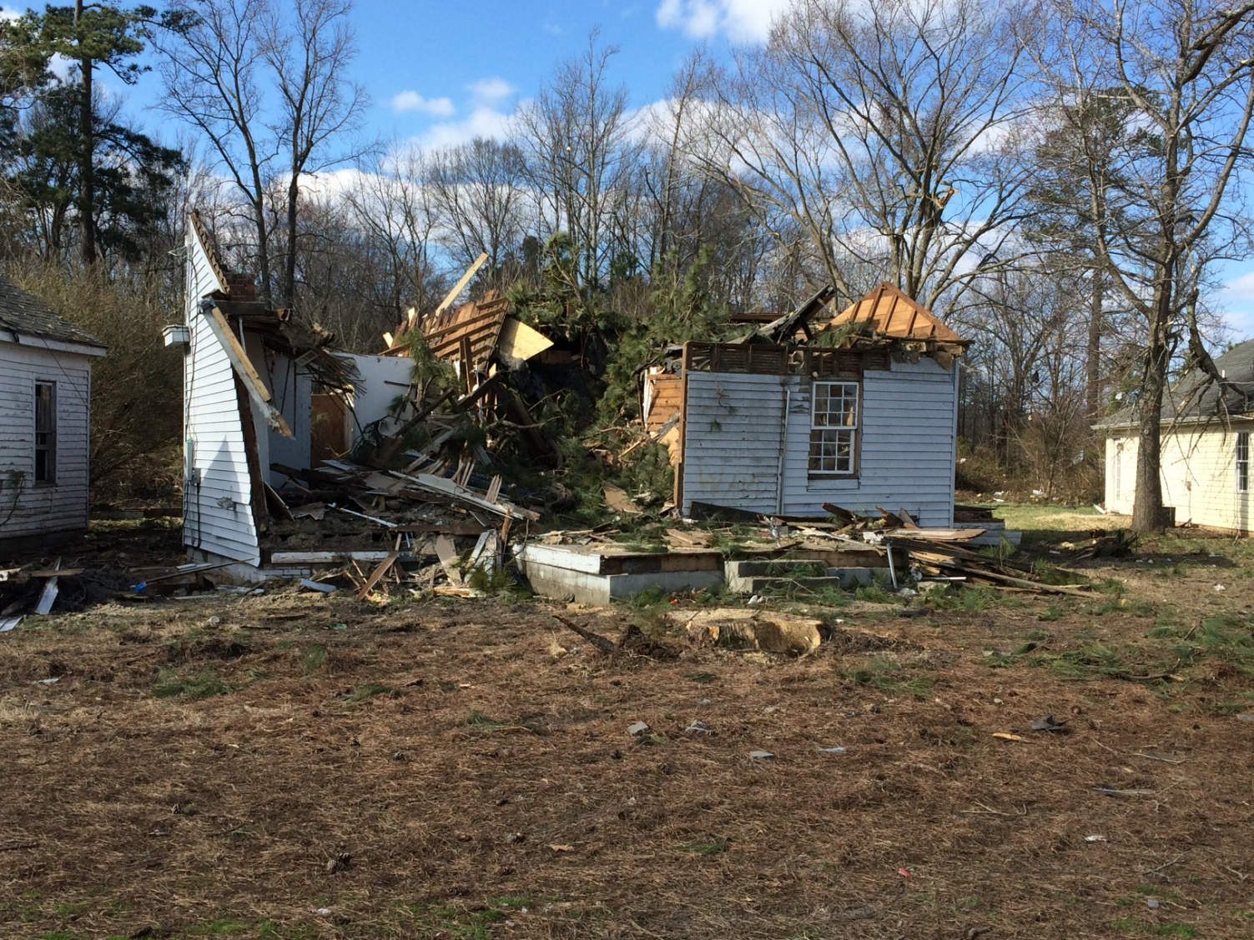
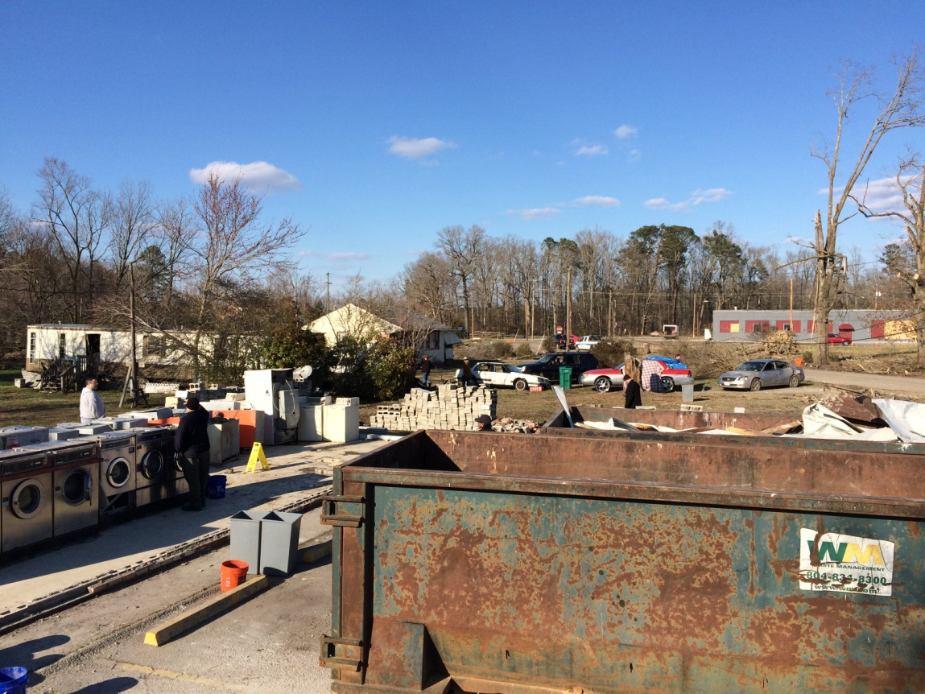
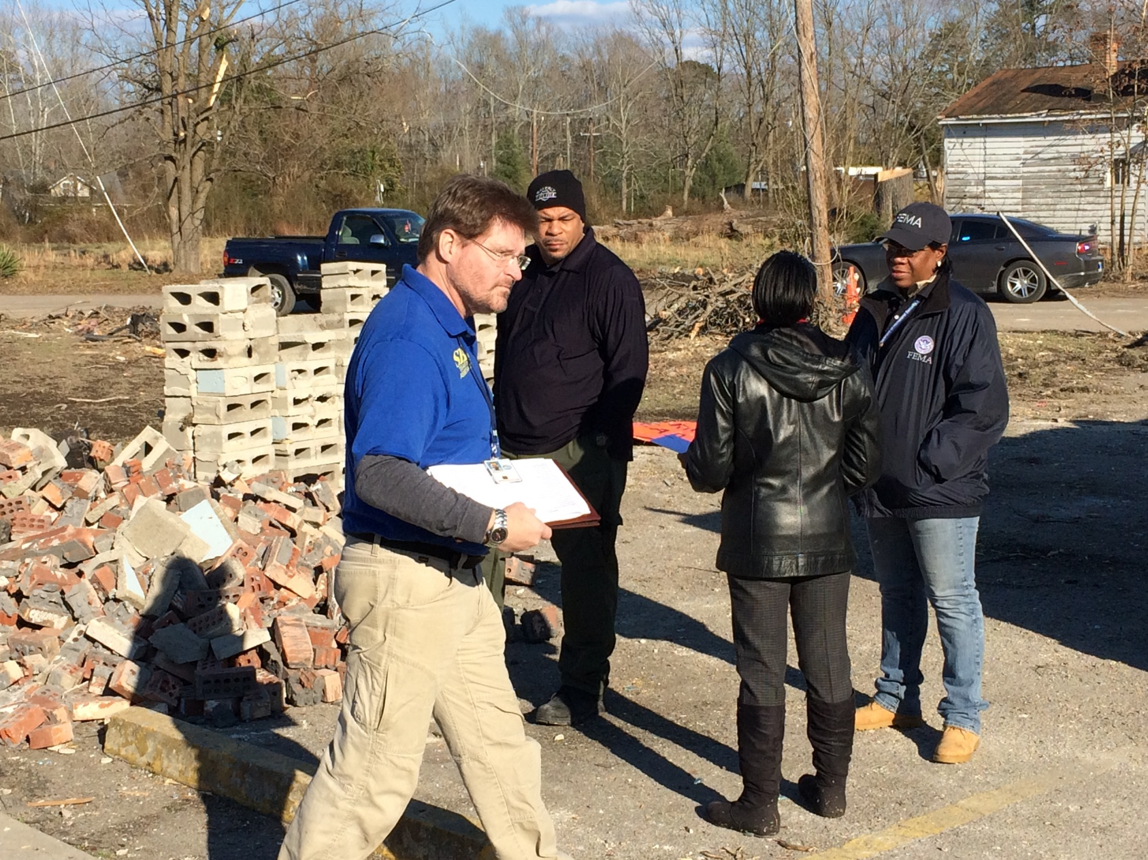
FEMA PDA Visit
Team Representation
VDEM (2)
DEQ (1)
FEMA (3)
SBA (1)
Waverly Police Chief
Waverly Mayor
Team met with county and town officials
Toured Waverly on Saturday
Toured other areas of the county and visited Surry County on Sunday

Slide 20
Contacts
Eddie Vick: Sussex County Emergency Manager
etvick@sussexcountyva.gov
(434) 246-1044
Bruce Sterling: Chief Regional Coordinator, Region 5
Bruce.sterling@vdem.virginia.gov
(804) 516-5786

Slide 21
Turn over to Gene and Bobby
Slide Hidden – for talking point use only

Slide 22
February 24, 2016 Tornadoes

Slide 23
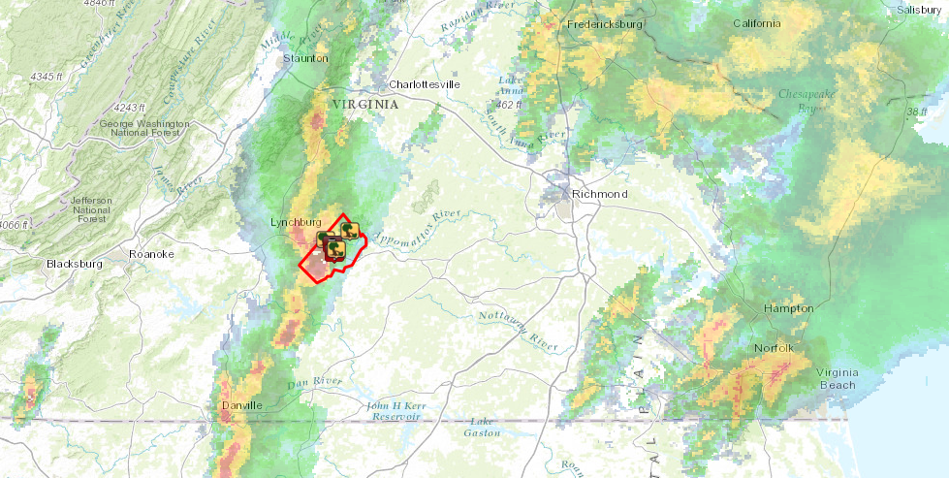
Appomattox Tornado
Tornado Warning
Issued 1527 hrs
Notes:
First Tornado Warning for Appomattox issued at 1527

Slide 24
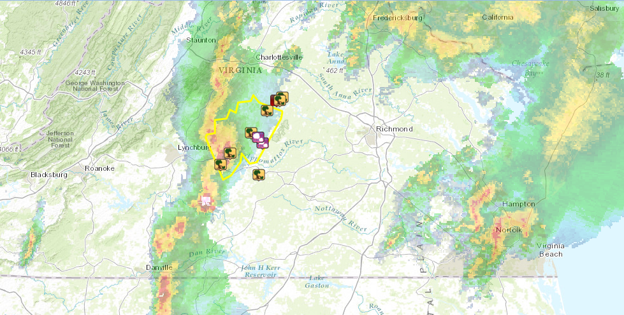
Appomattox Tornado
Severe Thunderstorm Warning
Issued 1539 hrs
Notes:
First T-Storm Warning for Appomattox issued at 1539

Slide 25
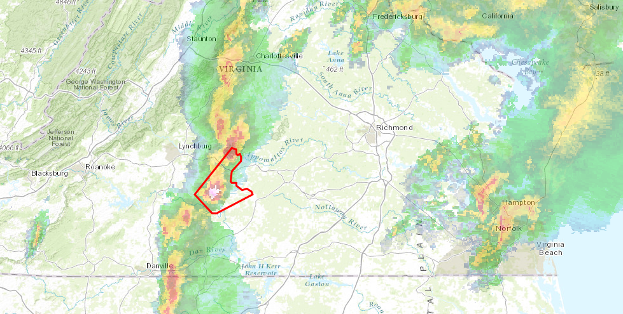
Appomattox Tornado
Tornado Warning
Issued 1543 hrs
Notes:
Second Tornado Warning for Appomattox issued at 1543

Slide 26
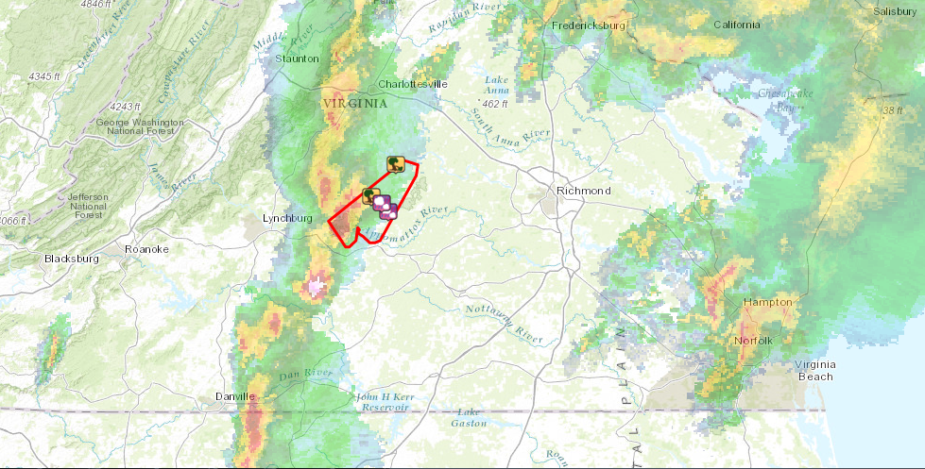
Appomattox Tornado
Tornado Warning
Issued 1545 hrs
Notes:
Third Tornado Warning for Appomattox issued at 1545

Slide 27
February 24th, 2016 Appomattox Tornado Timeline and Facts Tornado Watch #25 issued at 1:45 PM EST effective until 9 PM EST Tornado Warning #4 issued at 3:27 PM EST and specifically mentioned Evergreen in the path track:

Slide 28
The tornado touched down at 3:29 PM near the Campbell/Appomattox County line and was on the ground for 17.1 miles, lifting near the Appomattox/Buckingham County line at 3:44 PM. First EF3 (138-167 MPH) tornado in February in the Blacksburg forecast area. Before 2/24/16, there had been only six February tornadoes in the Blacksburg forecast area. Since 1950 there were only six confirmed tornadoes rated EF3 or higher in the Blacksburg forecast area. The 2016 Appomattox County tornado is #7.

Slide 29
This event was the first time a rare “debris ball” signature was observed on the NWS Blacksburg dual pol radar data, indicating debris lofted several thousand feet into the air.

Slide 30
Tornado Track

Slide 31
Tornado Debris Ball - Appomattox

Slide 32
This was the first event where NWS Blacksburg used unmanned aerial vehicles (UAV’s) to survey storm damage. This information resulted in nearly four additional miles of path length added to the initial ground survey. A special thank you to Appomattox County Emergency Management, VDEM, and the Central Virginia All-Hazards Incident Management Team for their assistance with the storm survey.

Slide 33
RESPONSE
Rapid response of local fire, EMS, and law enforcement
Worked endless hours confirming there was no further missing citizens
Fast response from VDEM, VDOT, power companies, and NGOs

Slide 34
AREAS TO DISCUSS
911 calls and response
Damage Assessment
Volunteer Management
Debris Management
Donation Management
Short and Long Term Housing
Long Term Recovery Group
Resiliency

Slide 35
Contacts
Bobby Wingfield: Appomattox County’s Emergency Manager
Bobby.wingfield@appomattoxcountyva.gov
(434) 352-3950
Gene Stewart: Chief Regional Coordinator, Region 3
Gene.stewart@vdem.virginia.gov
(540) 383-5126

